Slide 1


Slide 2



Project 2 (code: 491)
Machine Learning-Based IoT Wearable Device for Epileptic Seizure Detection
Supervisor: Dr. Mahmoud Saafan
Eng. Hossam Magdy Balaha
Eng. Shrouk Mohamed

Slide 3








Team Members:
Creative
Powerful
Fun!

Slide 4













Agenda:

Slide 5

Agenda:
Problem

Slide 6
Agenda:
Solutions

Slide 7
Agenda:
Challenges

Slide 8
Agenda:
Methodology

Slide 9
Agenda:
Results

Slide 10
Agenda:
Future Work

Slide 11

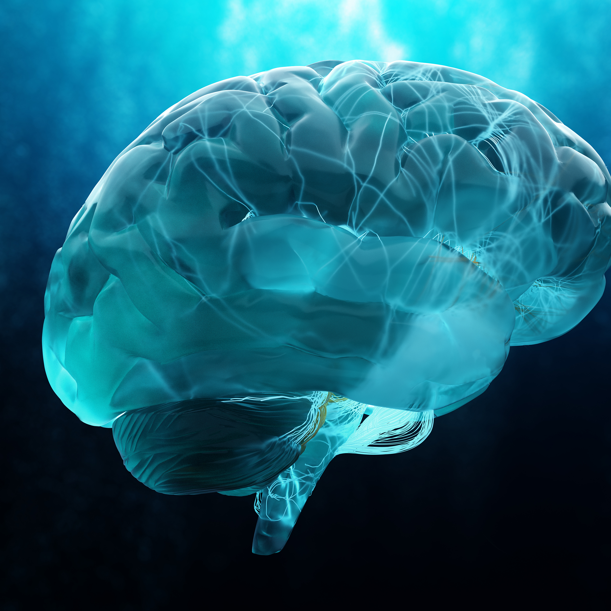
Problem:
50 Million in world suffering from Epilepsy
Five million are diagnosed with epilepsy each year.
SUDEP refers to deaths in people with epilepsy.

Slide 12
Epilepsy:

Slide 13
SUDEP

Slide 14
EEG and electrocorticography
Combined EEG systems
Combination of ECG and EEG data
ECG
Accelerometry
Combined accelerometry and
electrodermal activity methods
SOLUTIONS

Slide 15



Challenges:

Slide 16




Methodology
Electronics
3D design
IoT
Back end
Mobile app
ML

Slide 17
Requirement:
SENSORS
MICRO- CONTROLLER
POWER SOURCE
HW. SYSTEM

Slide 18
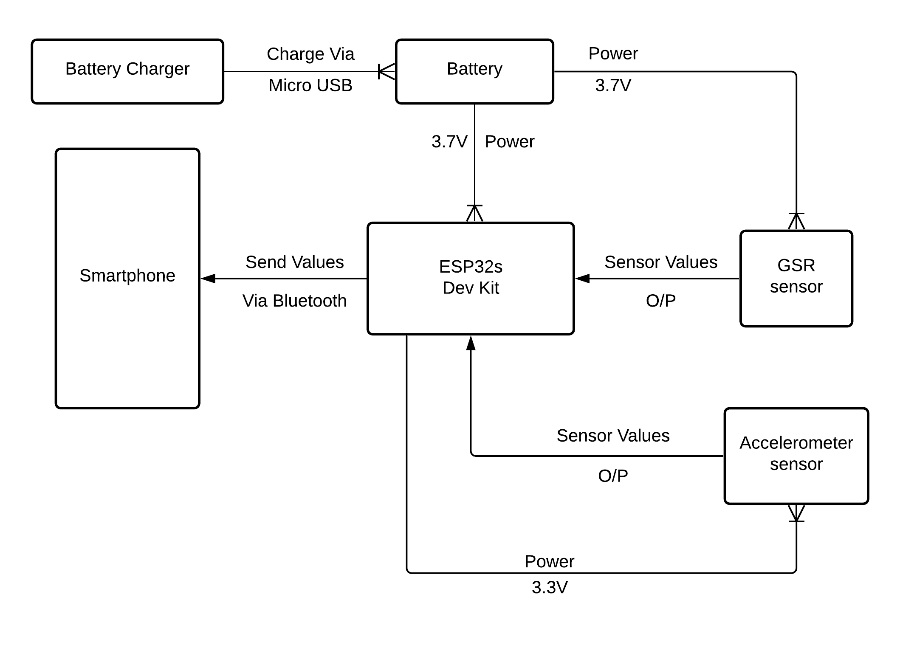

Slide 19
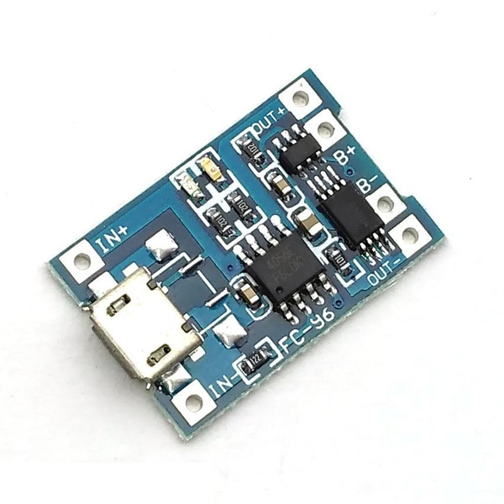
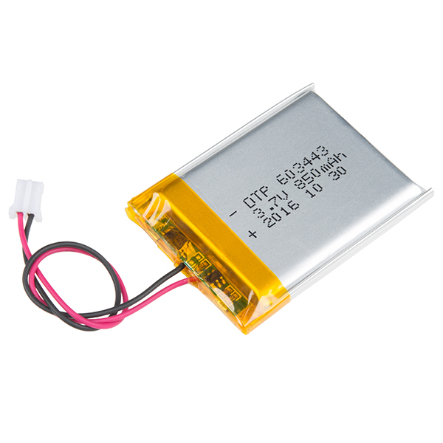
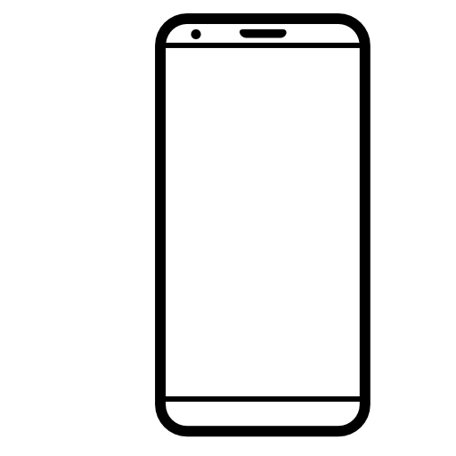
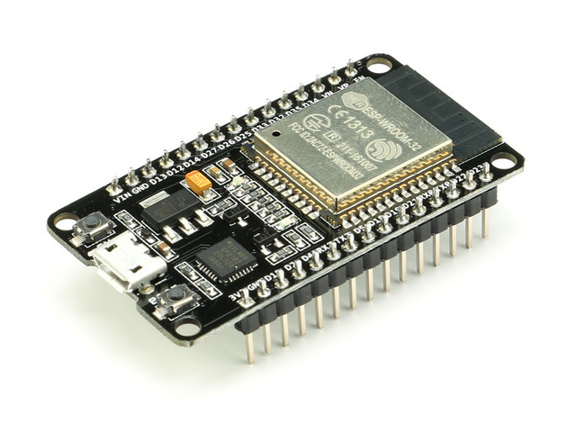
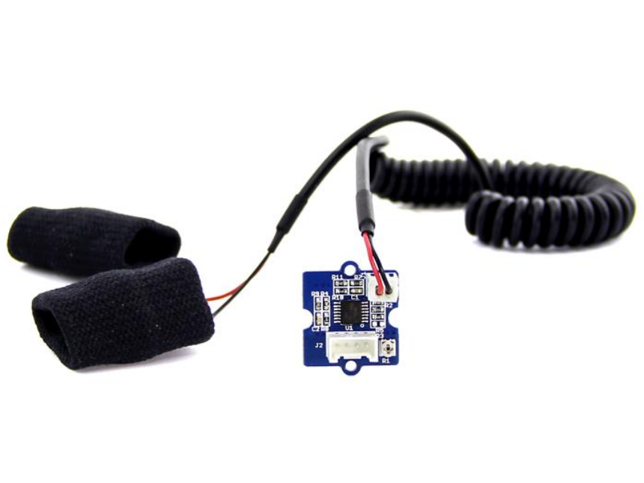

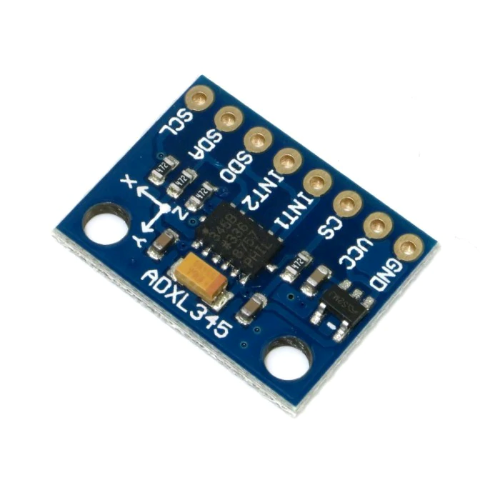
5 V
Micro-USB
Charging
3.7 V
3.7 V
Sensor
Values
Send Readings
Sensor Values
3.3 V

Slide 21
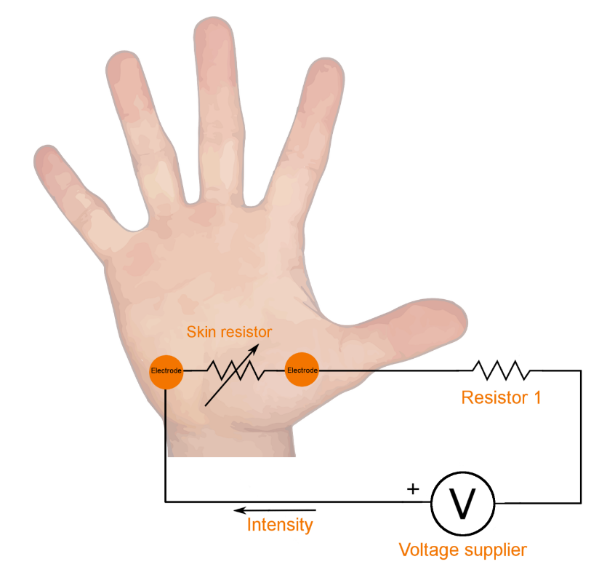

Slide 22
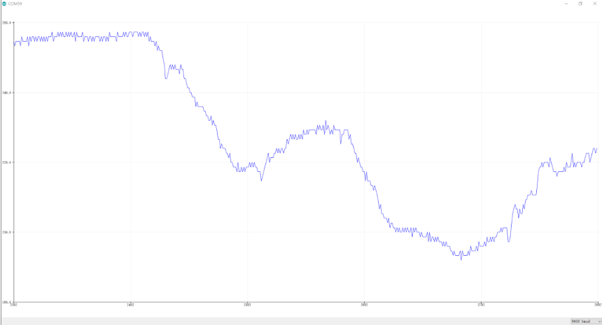

Slide 23
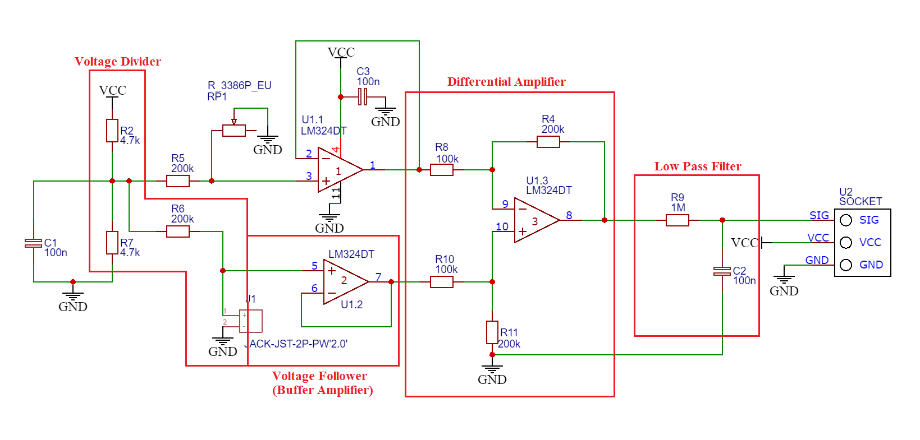

Slide 24
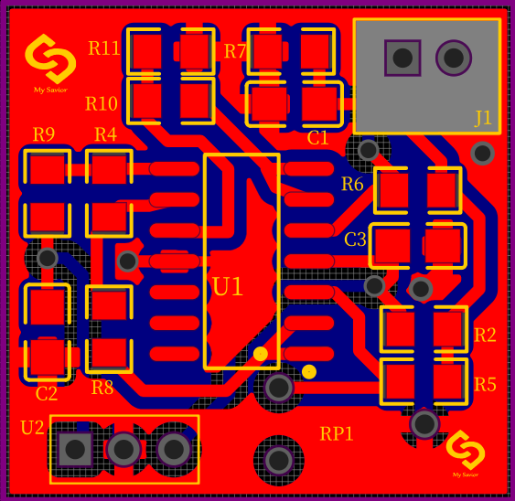

Slide 25


Design Requirement:
Light weight
Sensor
connect
Easy to wear
Wearable

Slide 26



Slide 27
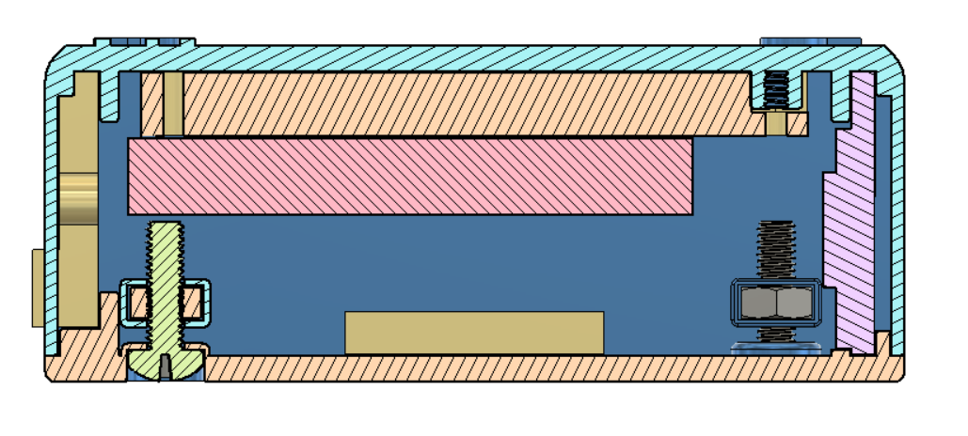
Han7ot sora hena le 5akl 2lgehaz 3al 7a2i2a men gowa 2abl ma n7ot 2lcomponents

Slide 28
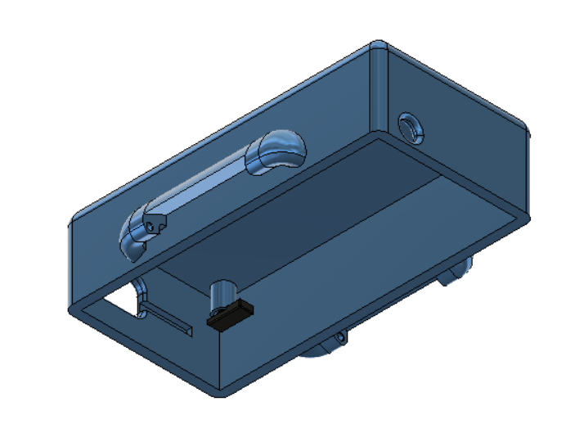
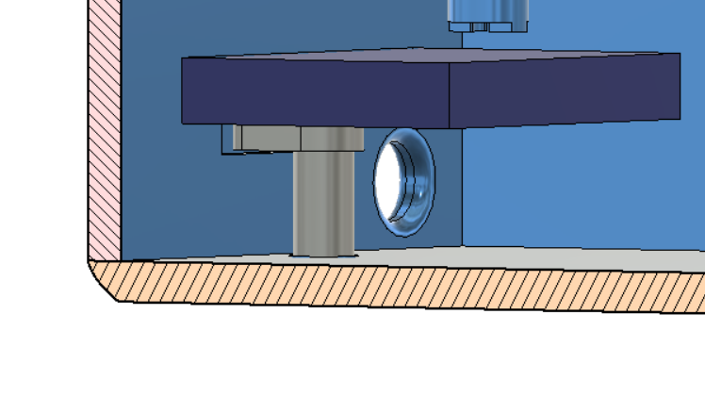
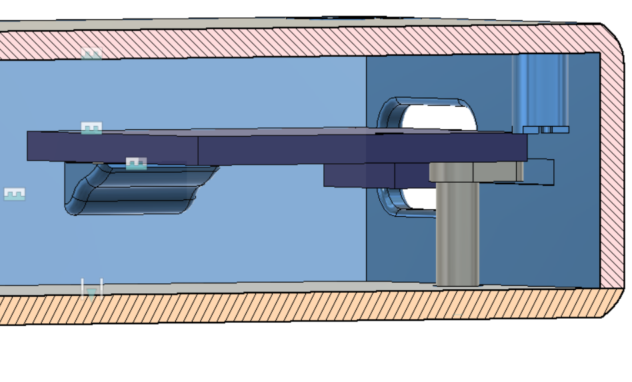

Slide 29


My Savior V2.0

Slide 30



Requirement of mobile app:
01
02
03
Alarm
Location
Access to data

Slide 31

Flutter:
Flutter is Google's UI toolkit for building beautiful, natively compiled applications for mobile, web, and desktop from a single codebase.
Flutter works with existing code, is used by developers and organizations around the world, and is free and open source.

Slide 32
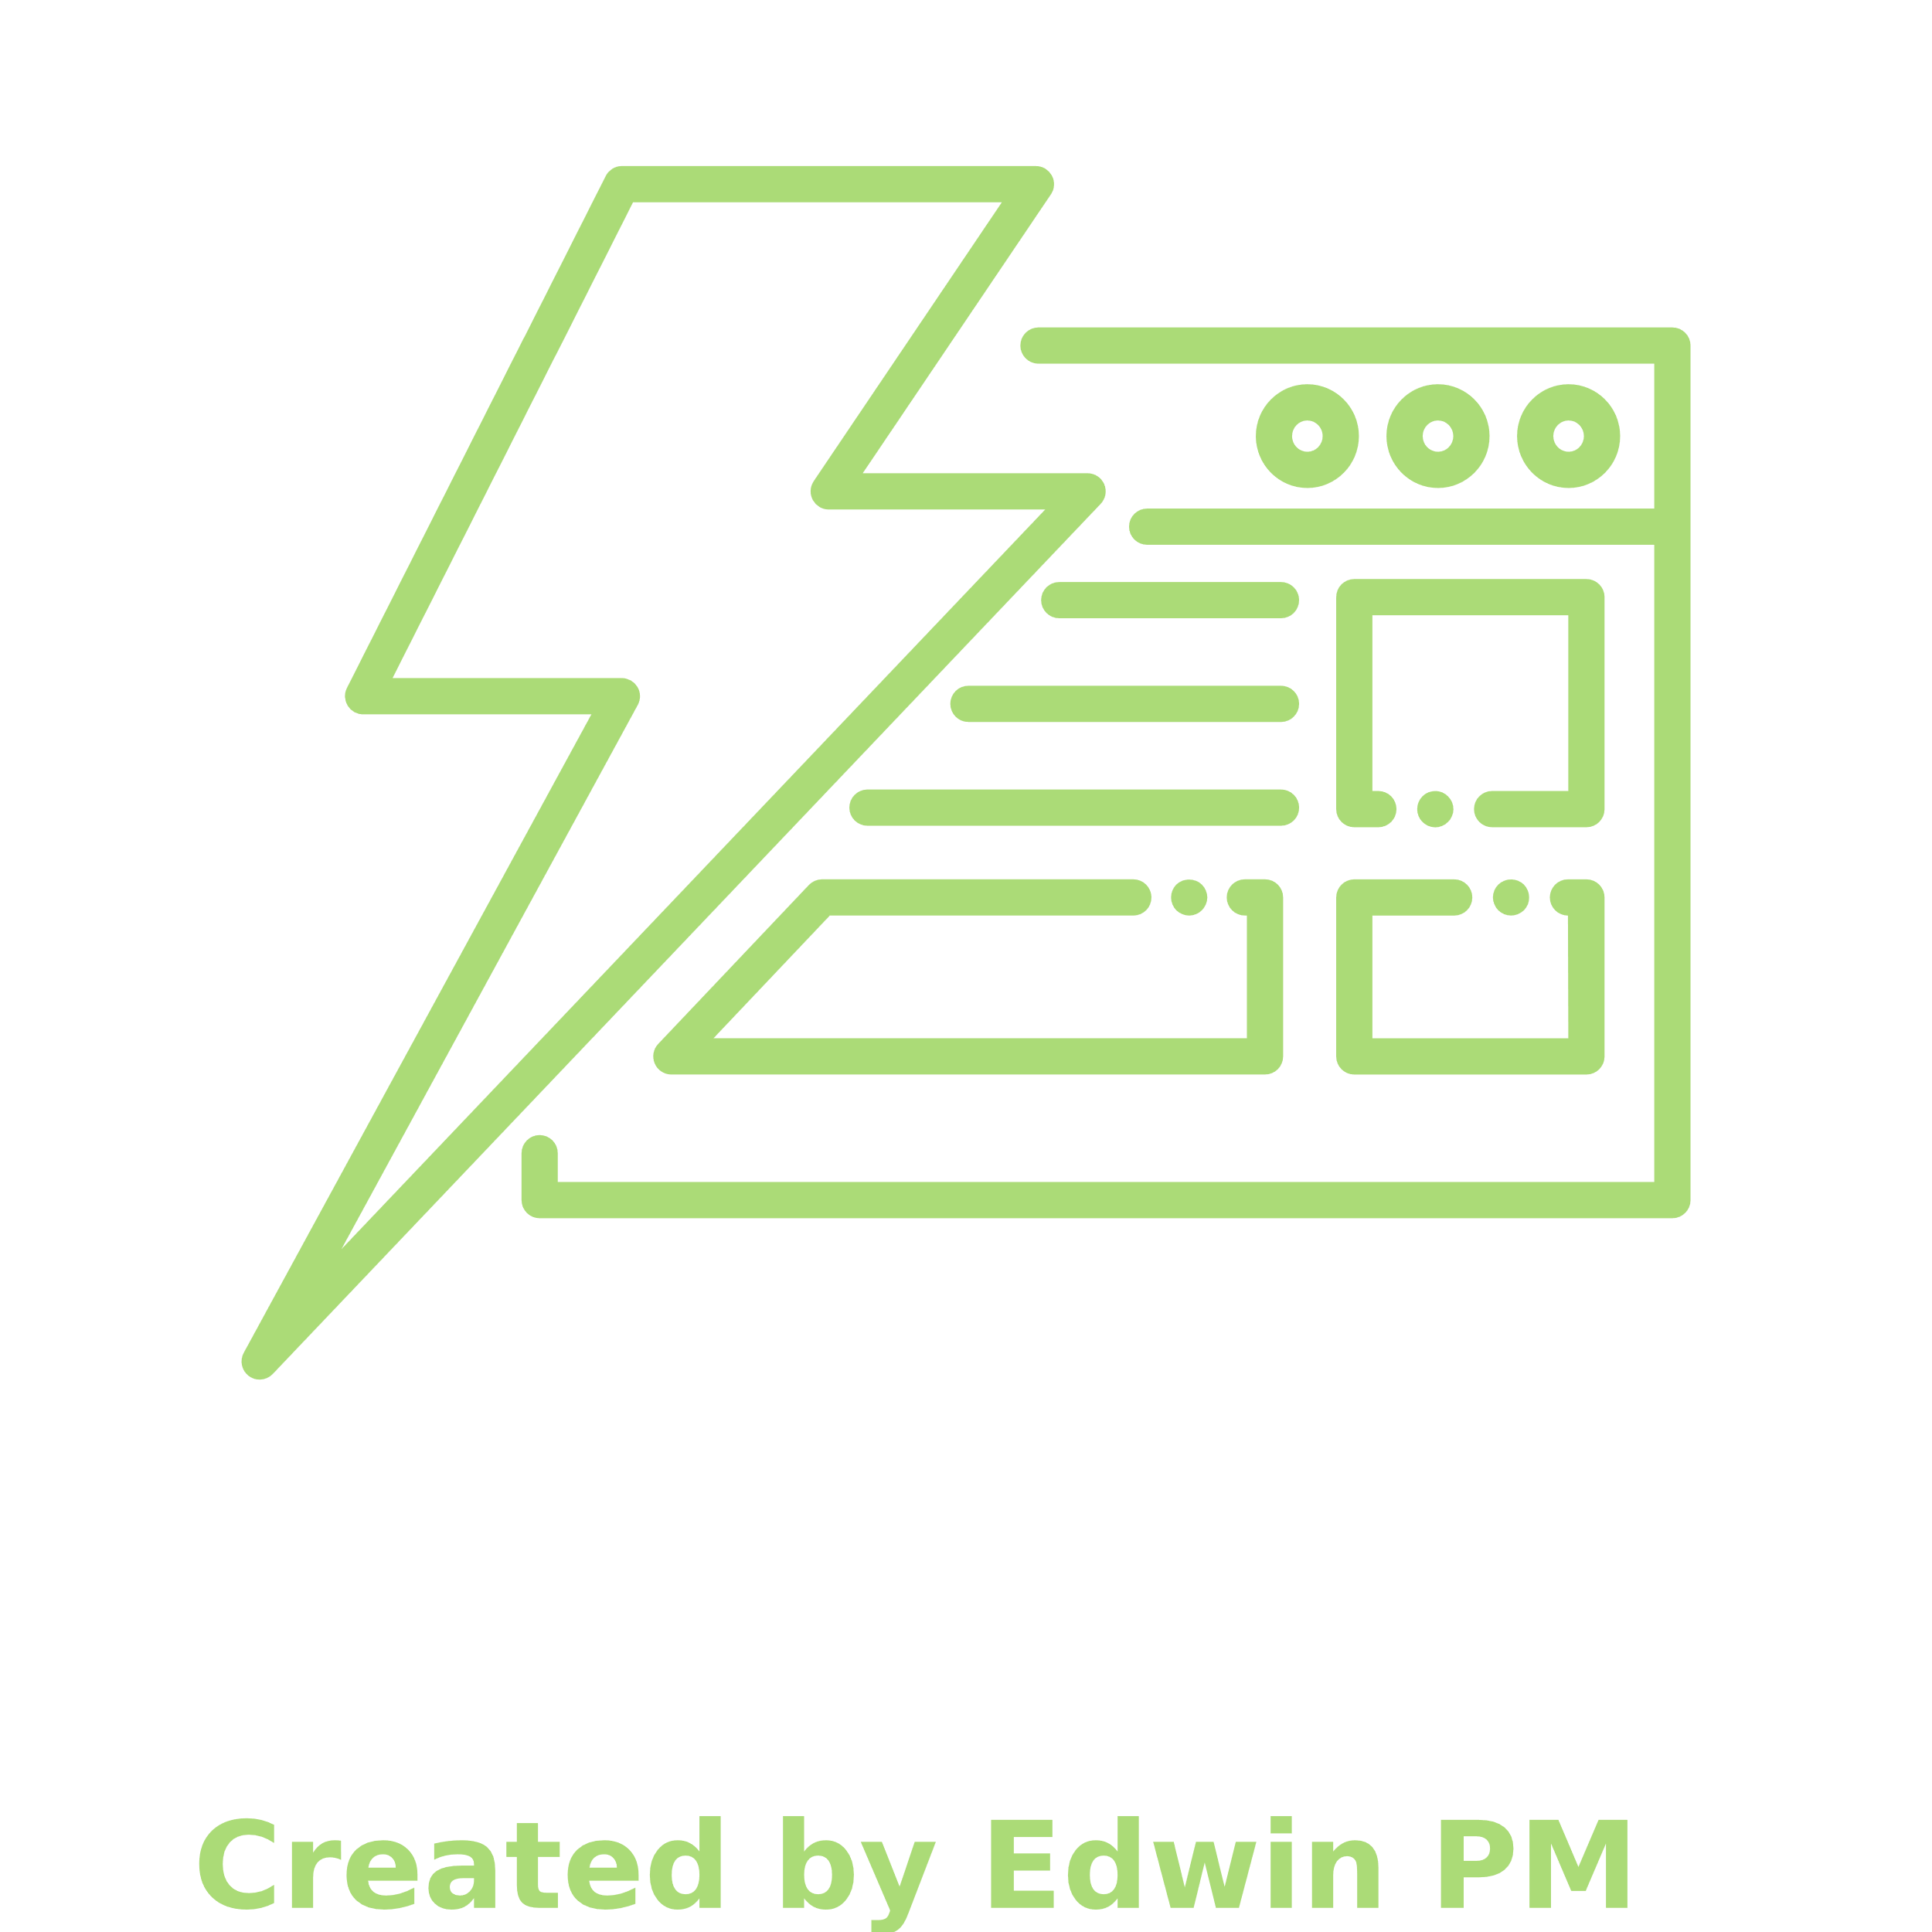




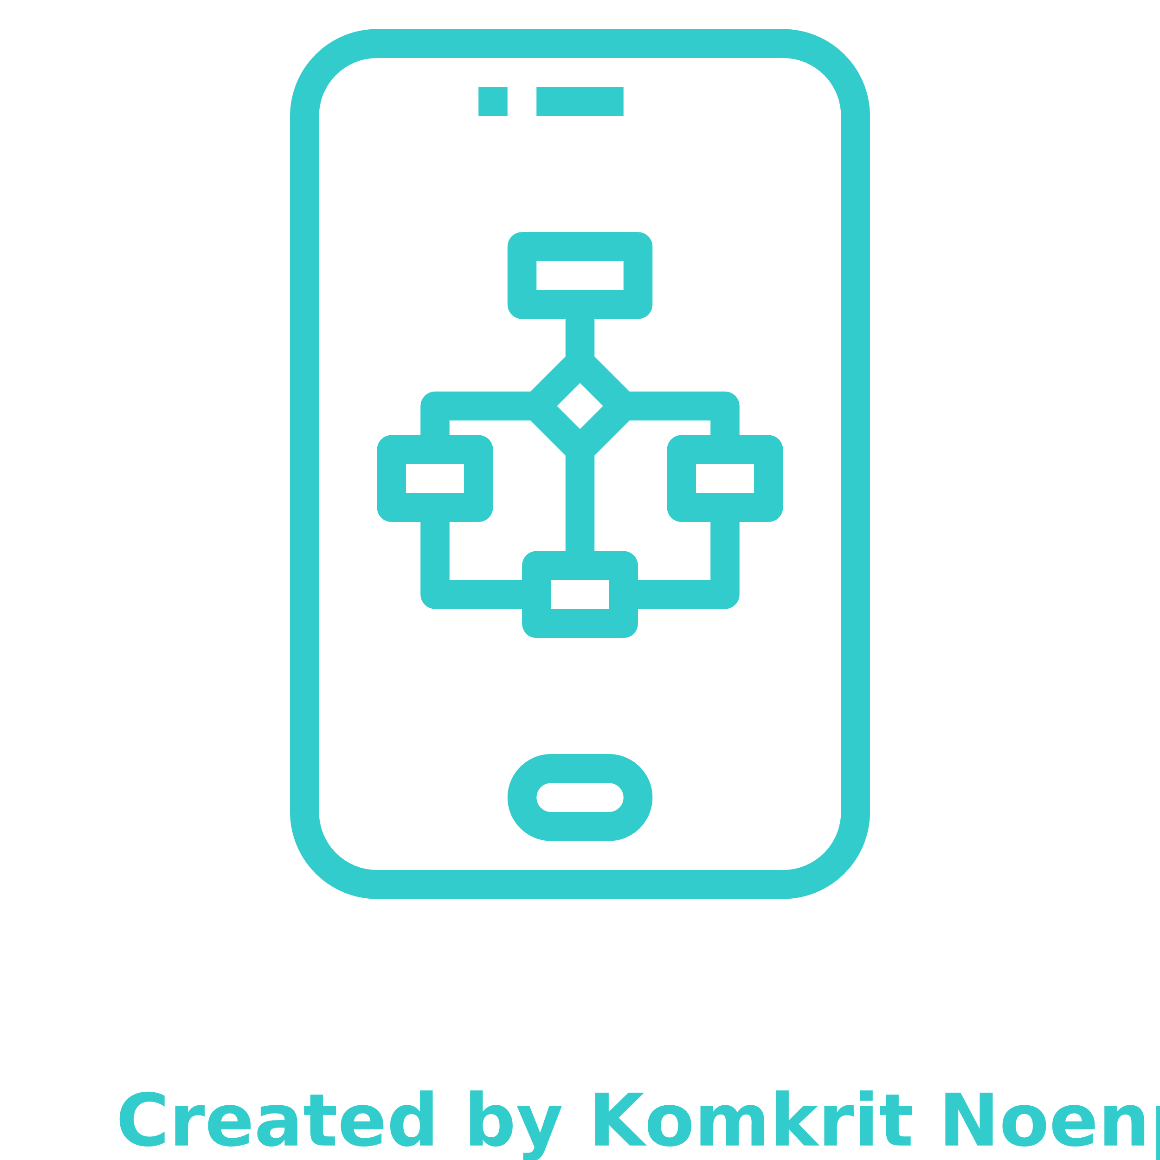
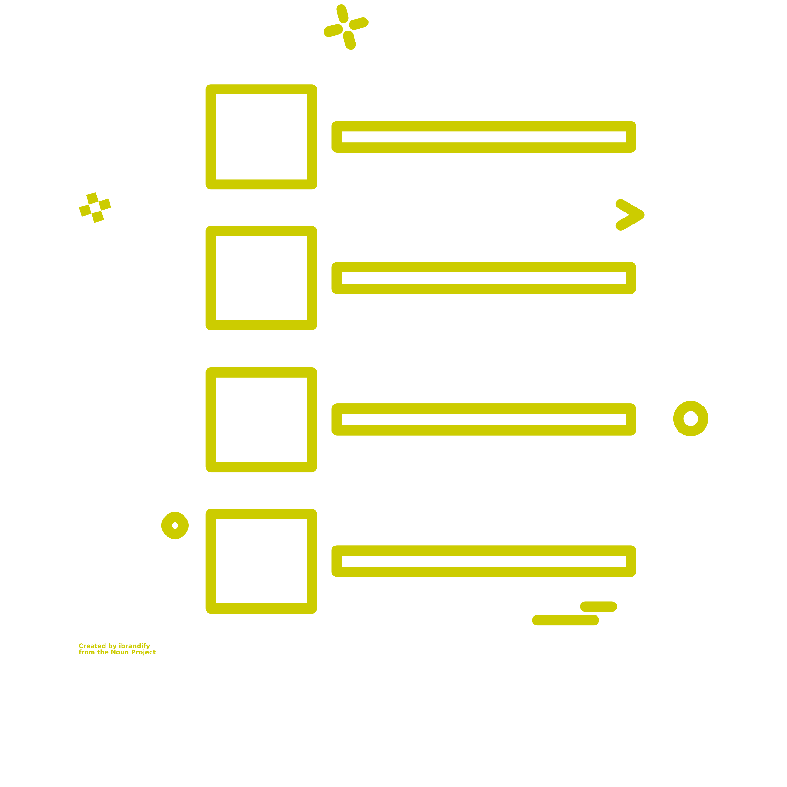

Flutter:
Fast development
Native performance
Hot reload
Pixel perfect
Offers a lot of widgets
Uses dart language
Expressive & fixable UI
Cross platform

Slide 33

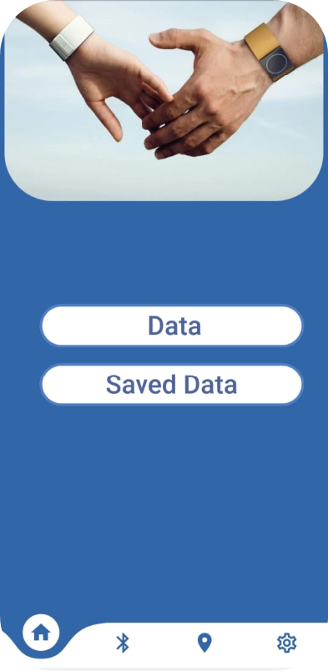
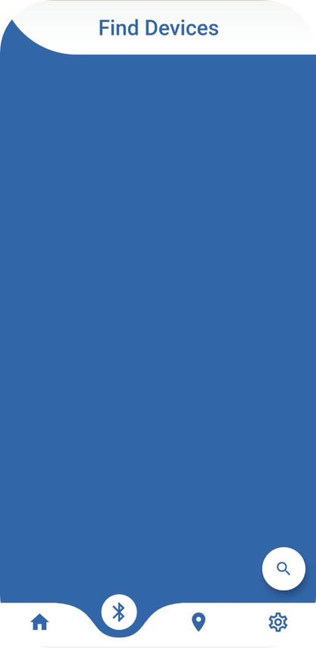
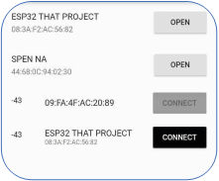
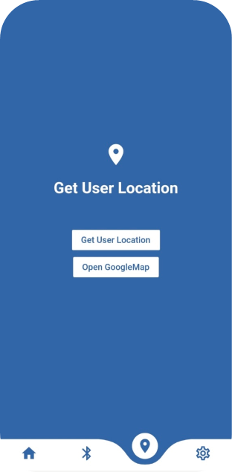
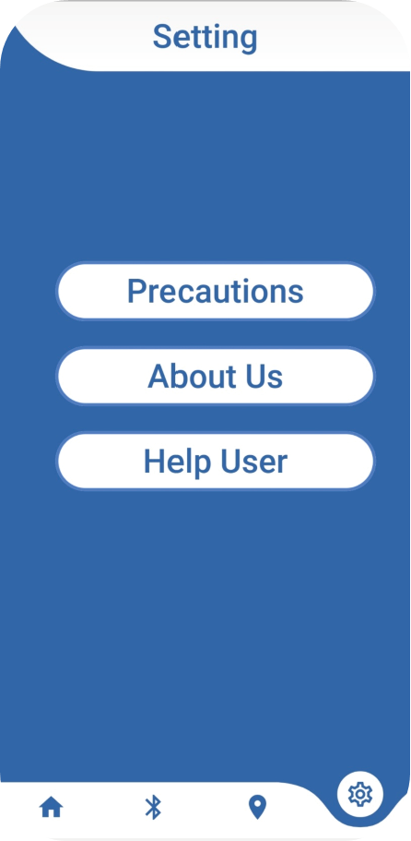
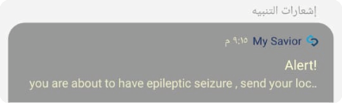
App Screens:

Slide 34
App Screens:

Slide 35
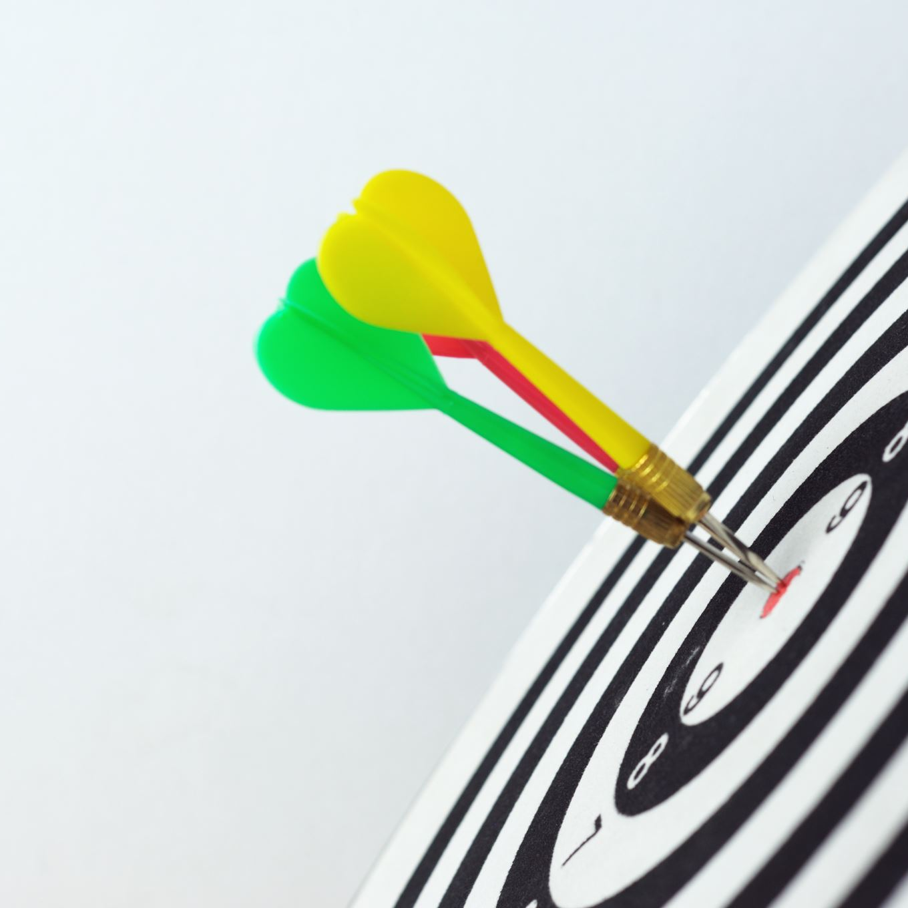
Objectives:
The main goal of this machine learning model is to classify the incoming signals into epileptic seizures or not by supervised learning, in order to give the patient a timely alert.

Slide 36





Data overview:
Spanish dataset.
5 Col. And 161 Rows
EDA Sensor reading
Features and its class.

Slide 37
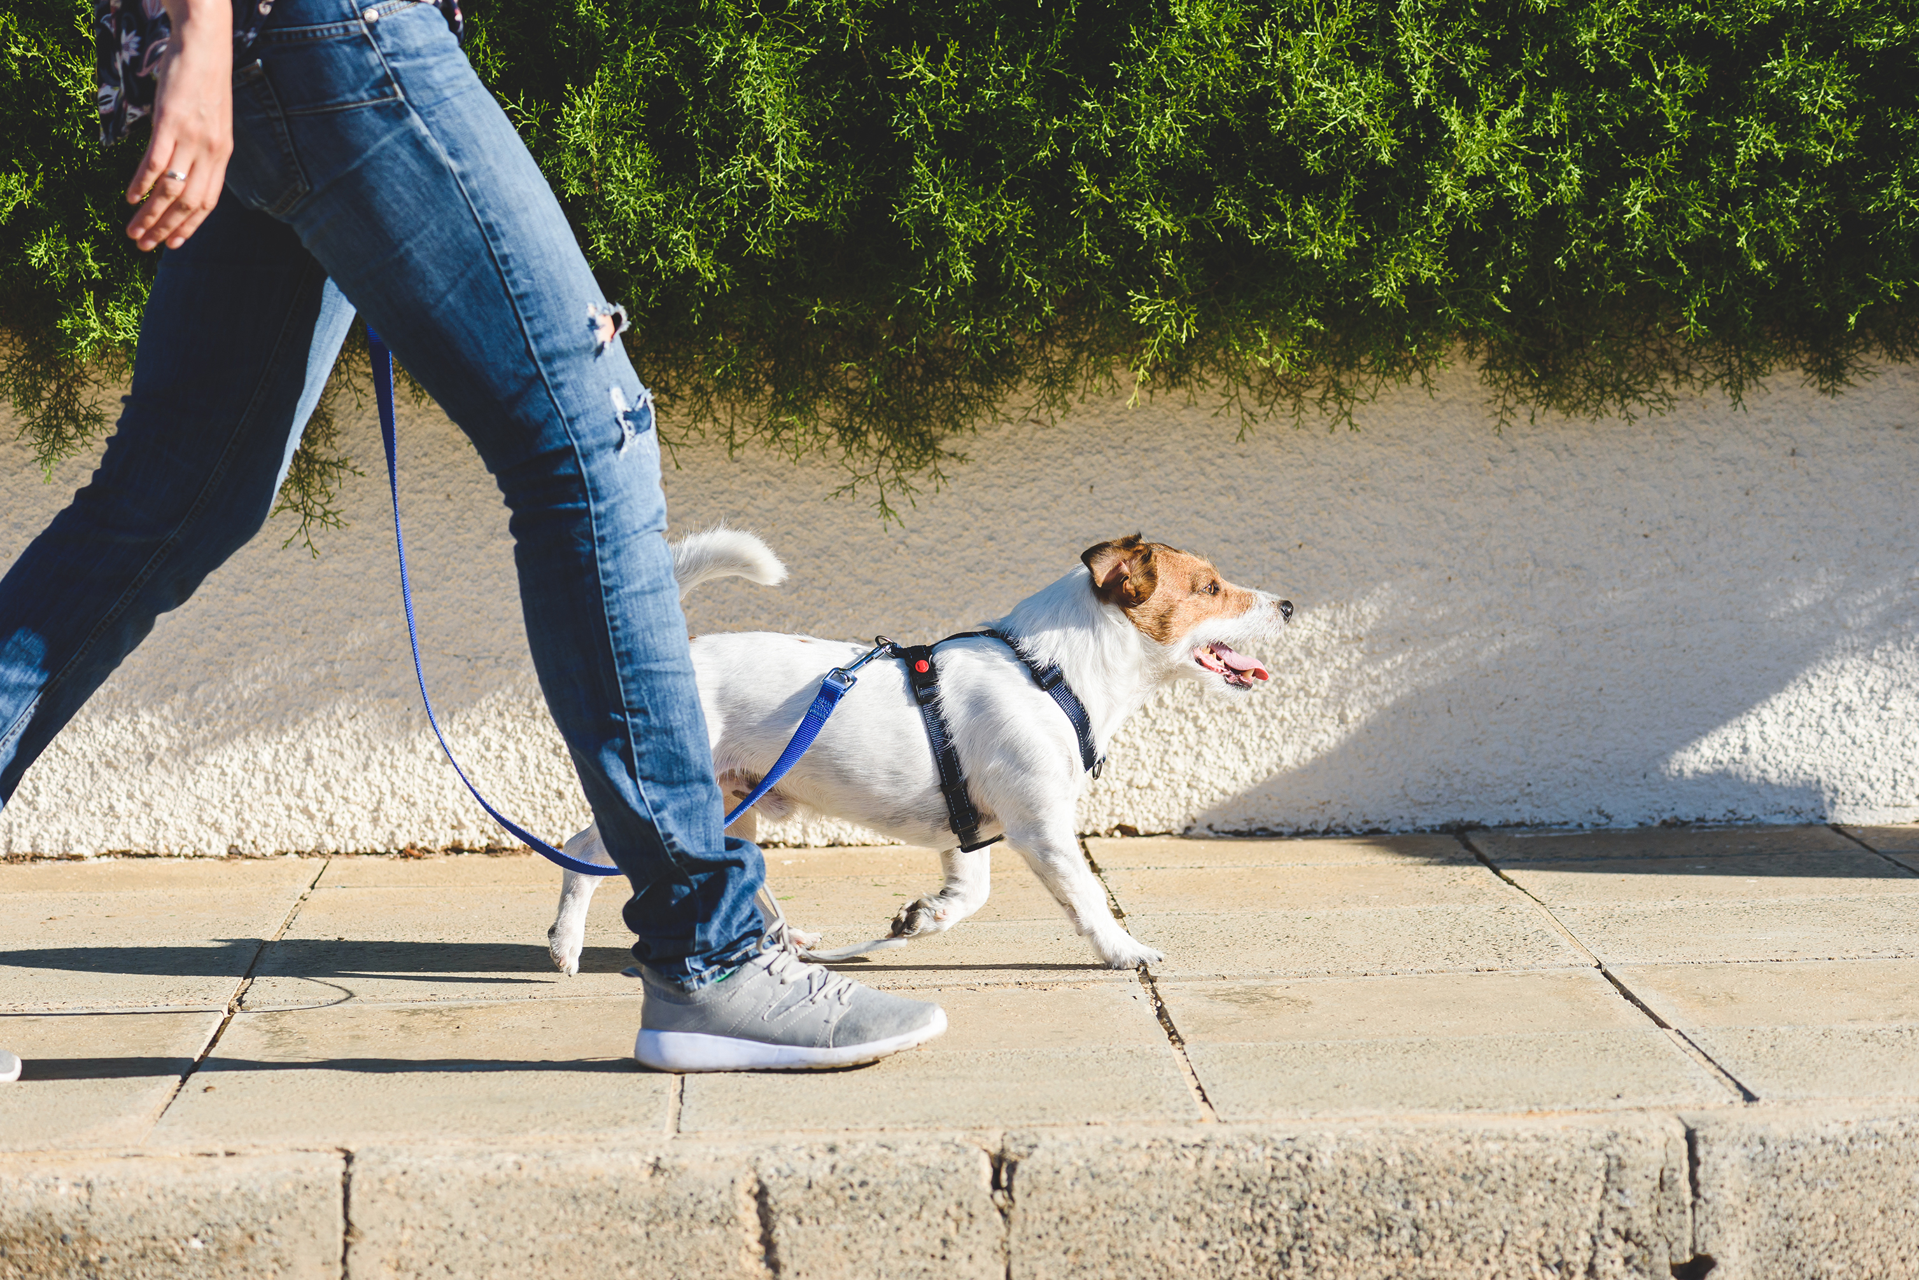


Classes:
Walking
Running
Seizure

Slide 38



Features:
Minimum
Maximum
Median
Variance

Slide 39
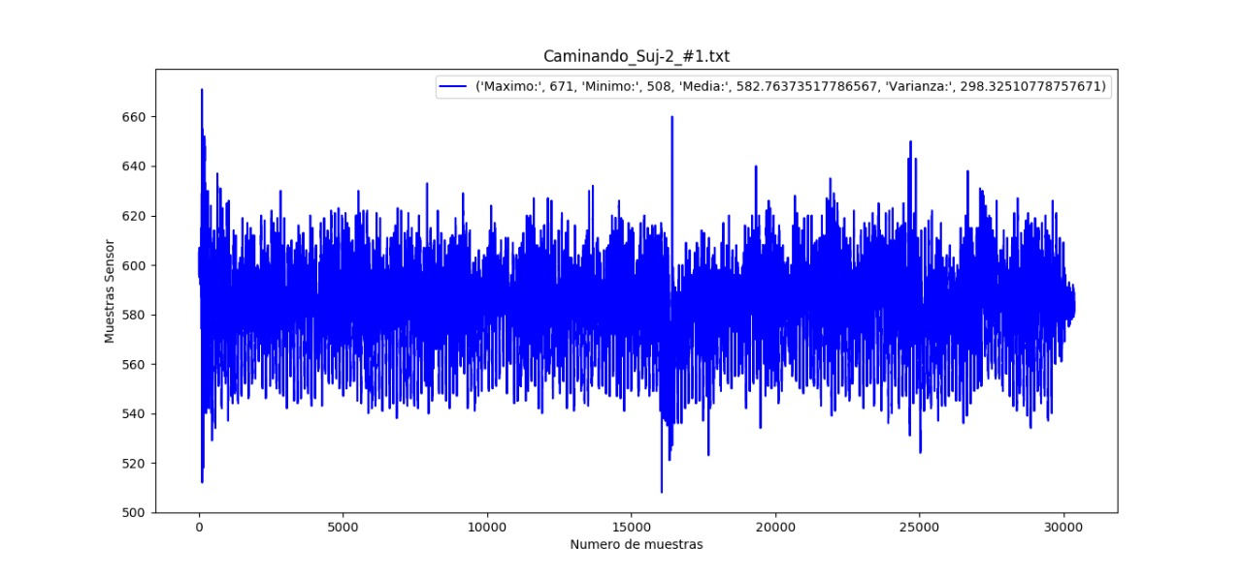
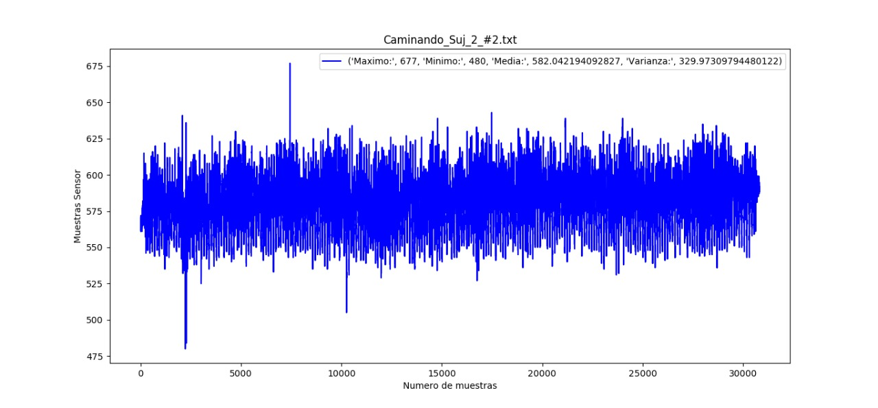
Class 1: Walking

Slide 40
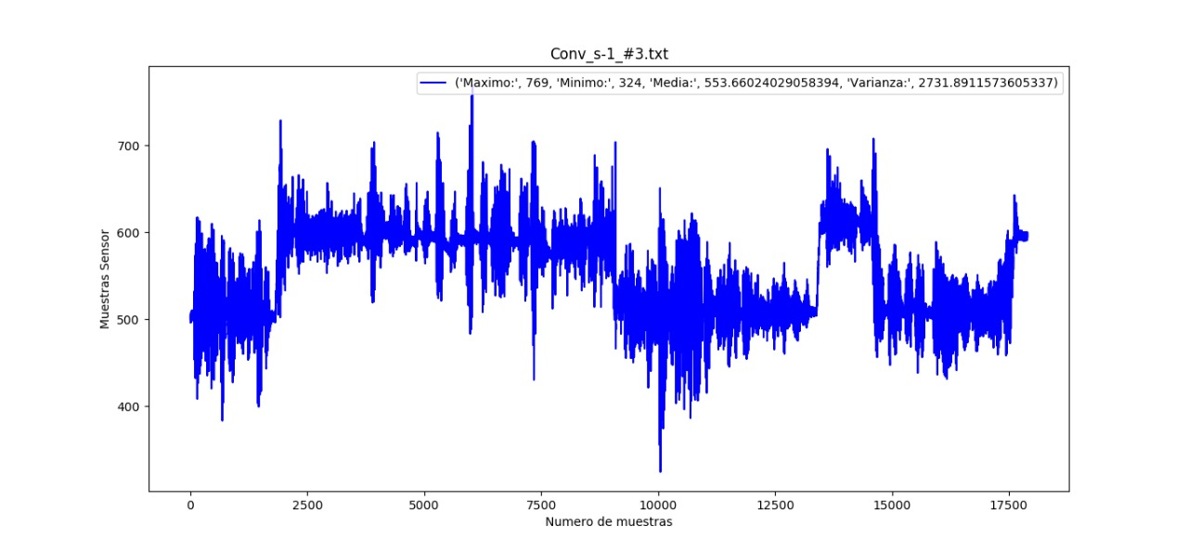
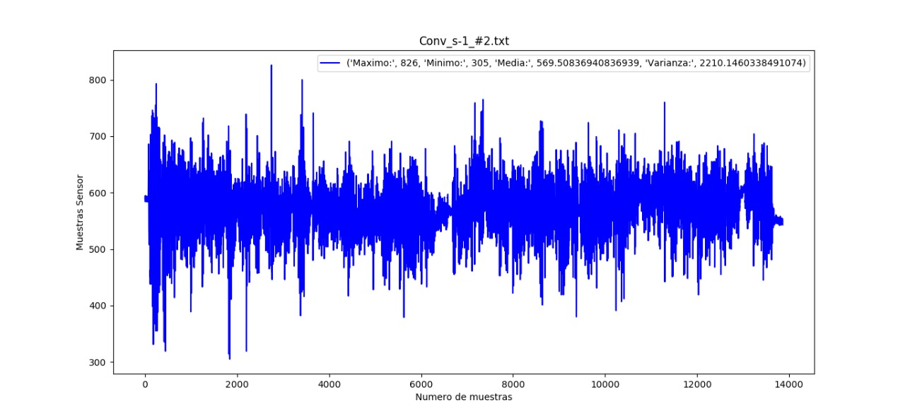
Class 2: Epileptic seizure

Slide 41
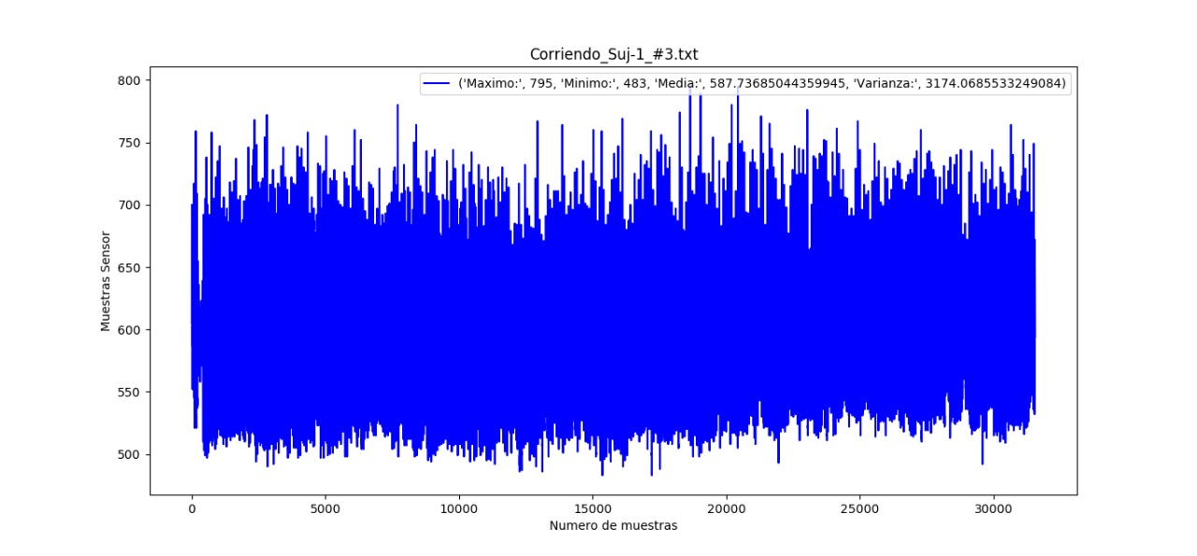
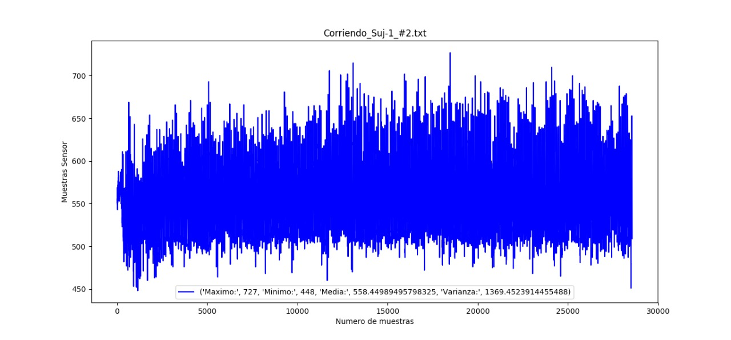
Class 3: Running

Slide 42
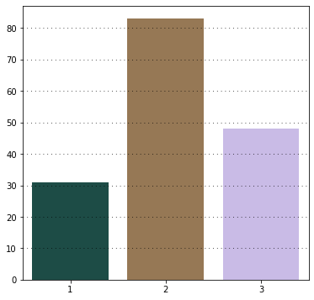
Records:
The figure shows that class 2 has more records than other classes.

Slide 43
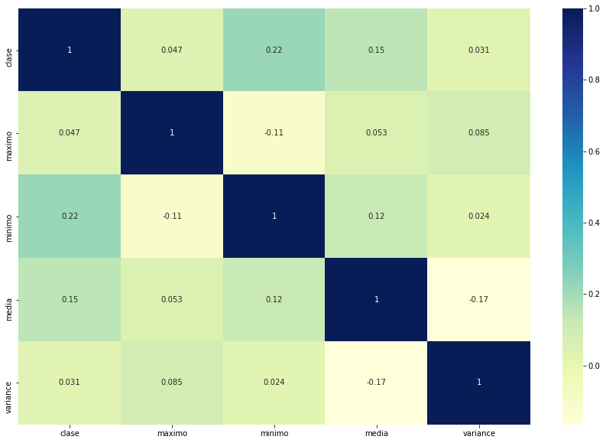
Correlation:

Slide 44





Classification models:
SVM
K-Neighbors Classifier.
Decision Tree Classifier.
XGB Classifier.
Random Forest Classifier.

Slide 45
Classification models:
01
02
03
04
Initialize
Train
Predict
Evaluate

Slide 46
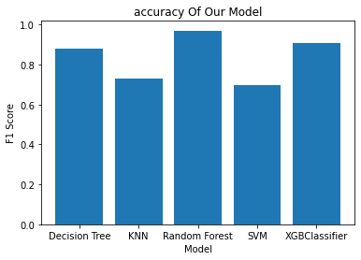
Accuracy:
The random forest algorithm is the most accurate and compatible algorithm with an accuracy of 97%.
So, we selected it for learning the model.

Slide 47
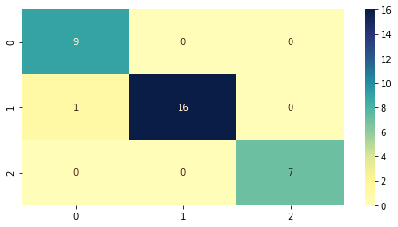
Confusion Matrix:

Slide 48
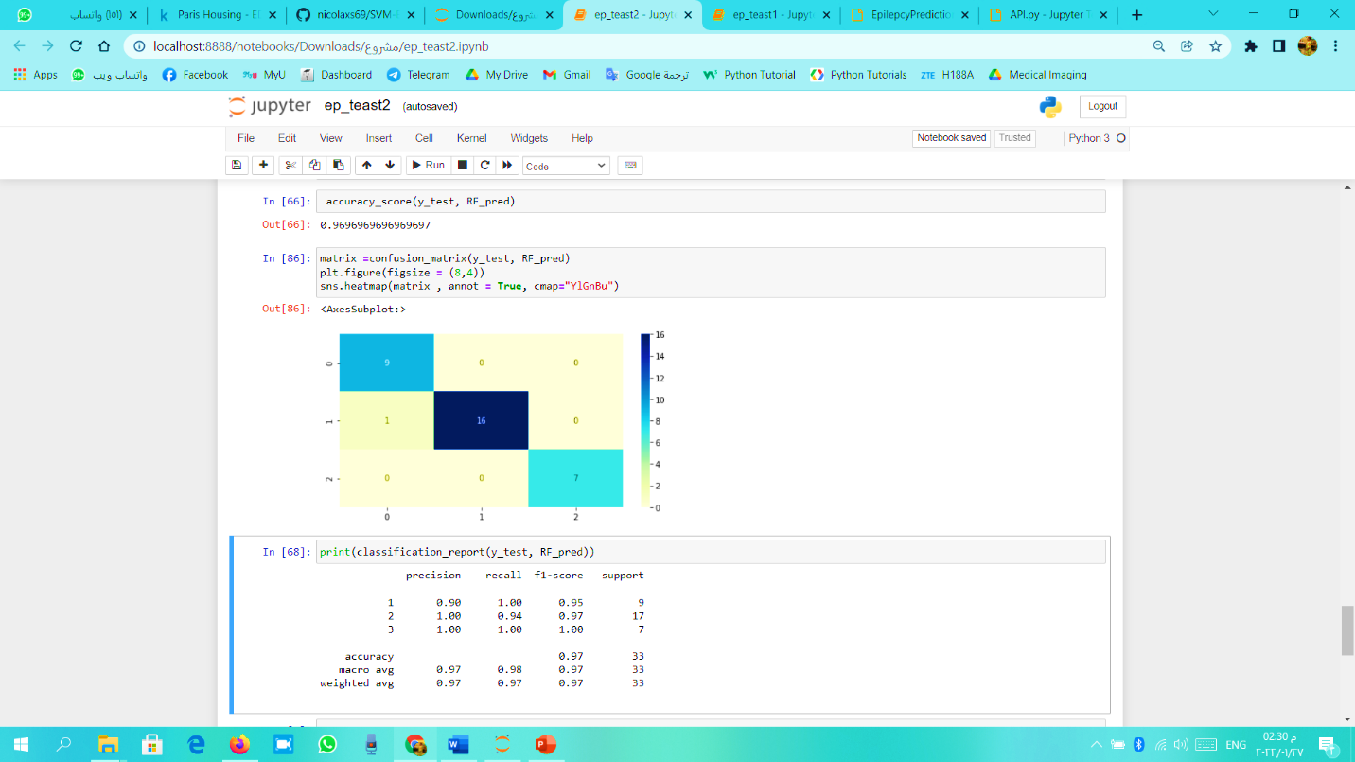
Classification report:

Slide 49

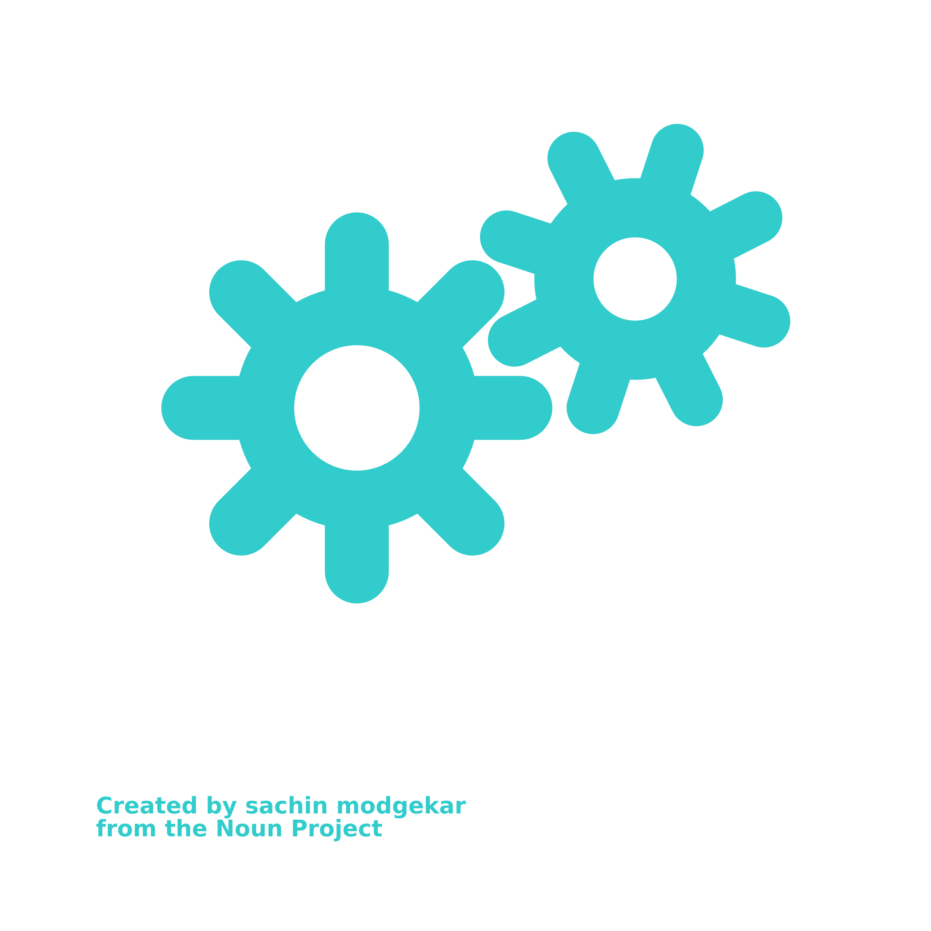


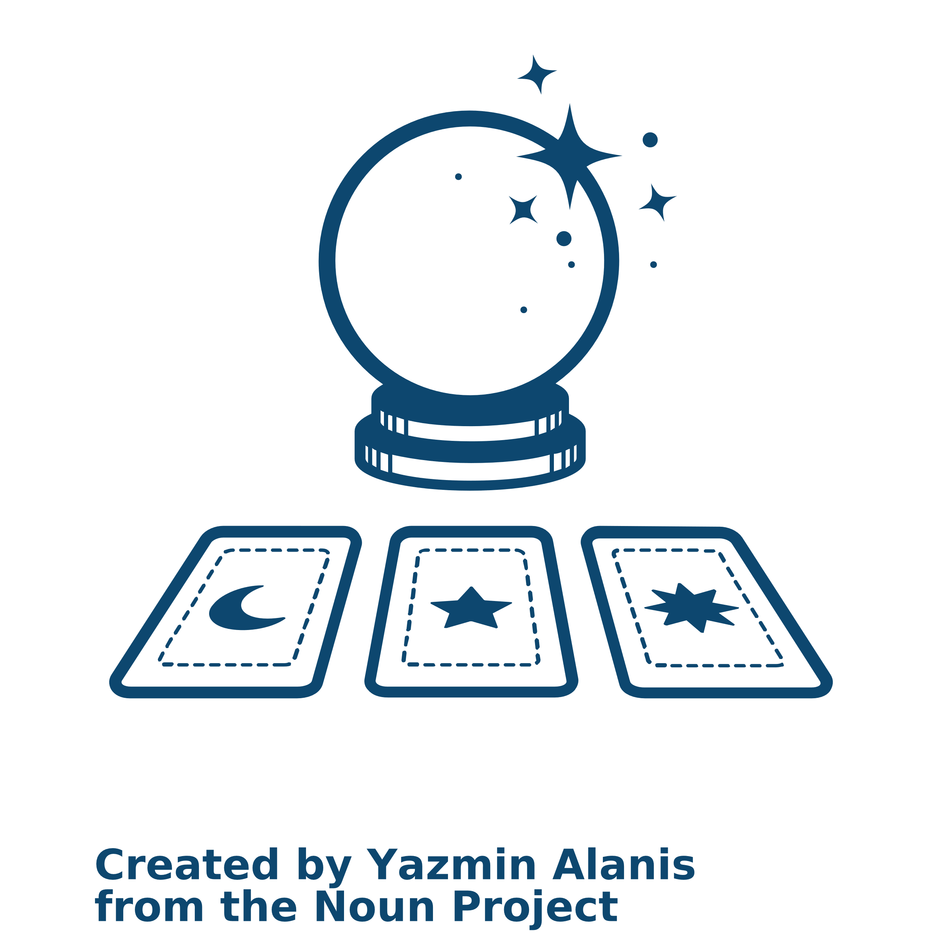
preprocess function.
train function.
evaluate function.
predict function.
ML real-time app:
get_data function.
preprocess function.
train function.
evaluate function.
predict function.

Slide 50


preprocess function.
train function.
evaluate function.
predict function.
API: “Application Programming Interface”
End user
API Request
Server
API Response

Slide 51


Back-end:

Slide 52
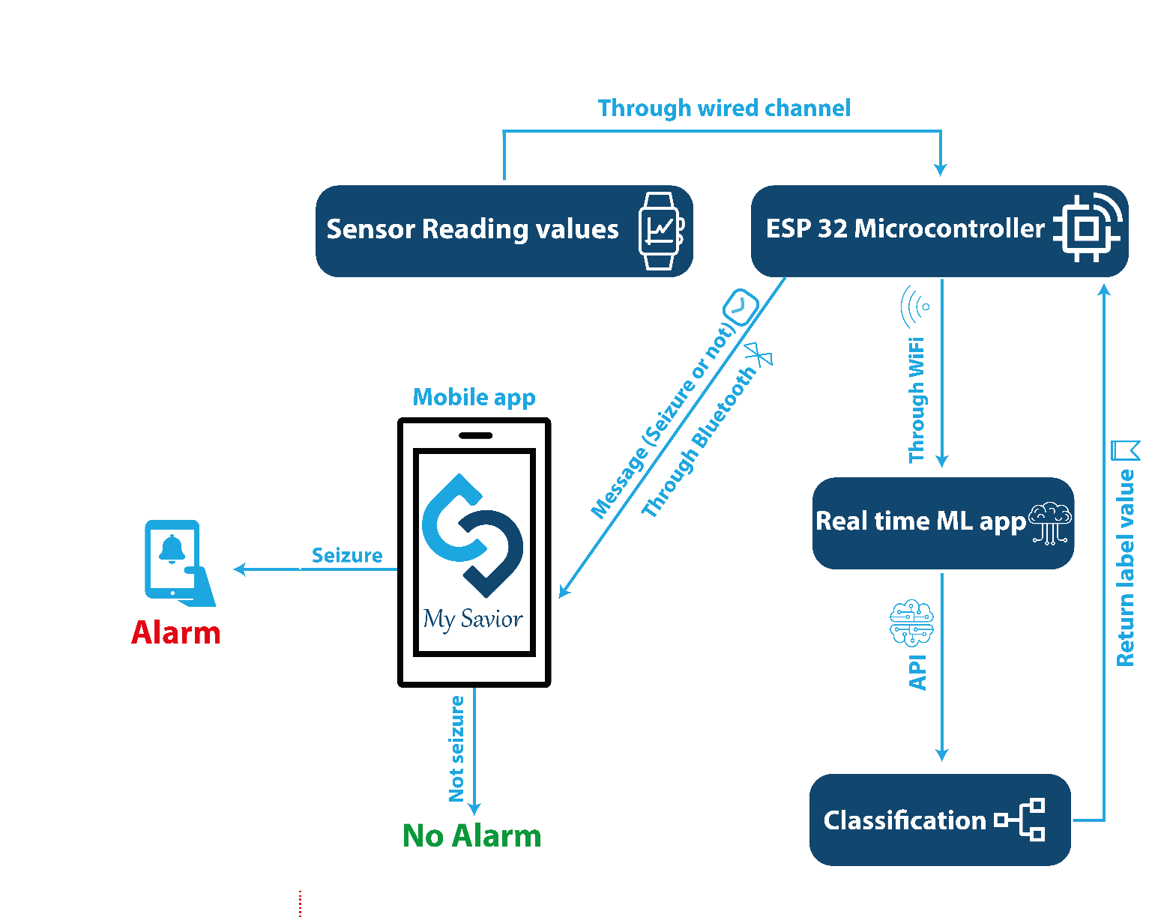
Device-Block diagram:

Slide 53
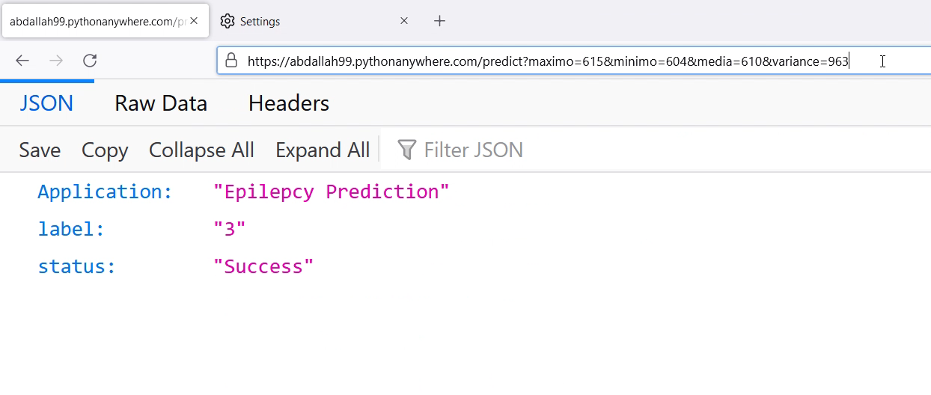

Slide 54
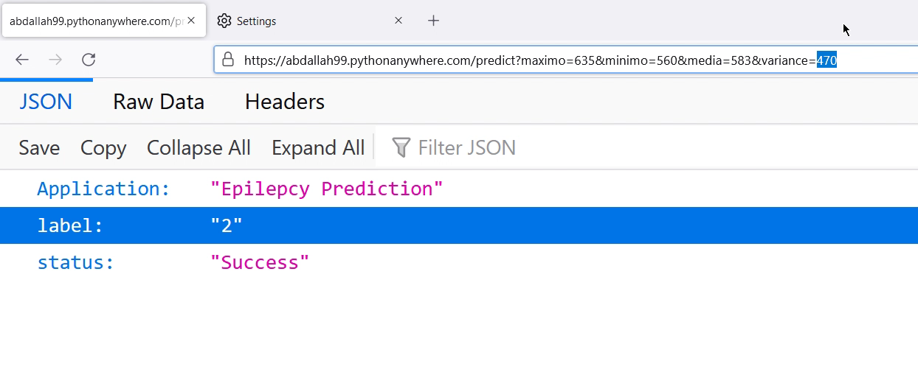

Slide 55
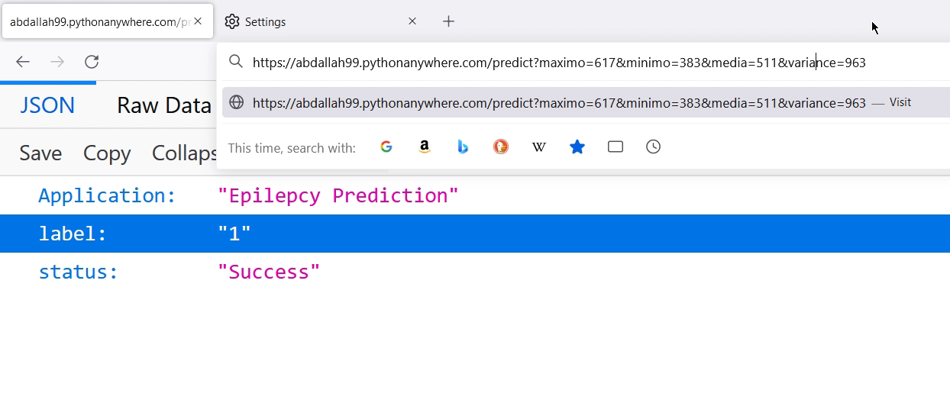

Slide 56
Future work:
My Savior
Mobile app updates
Deep learning
Smart watches app
Closed loop system

Slide 57
“Since we are biomedical engineers, we believe that we must make people's lives more comfortable and patients' lives less painful”

Slide 58
My Savior
THANKS

